Slide 1
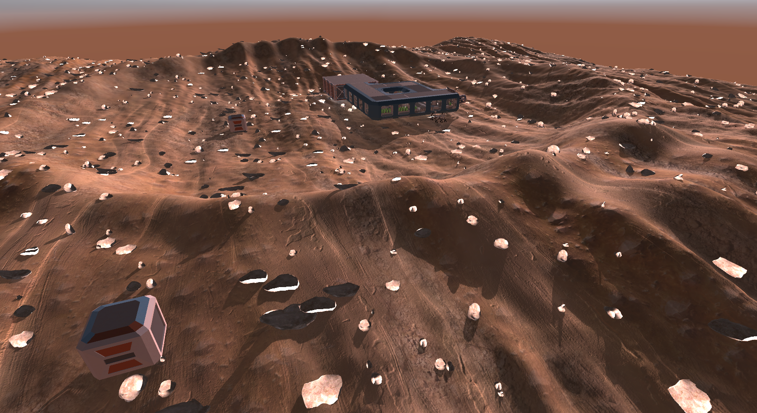
m(A*)rs
Logan Pickell
Distributed Computing Final

Slide 2
What to expect
Game objects
Dive into the A* agent components
How I spawned the agents
Optimizations
Future additions to this project
Multithreading used in my summer internship software

Slide 3
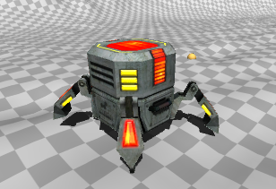
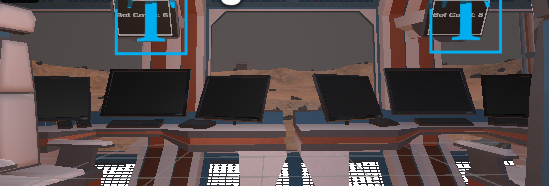
Game Objects
Pathfinding Agent
Mars Terrain
Mars Station
Supply Crates
Computer Monitors

Slide 4
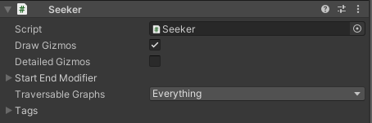
Seeker
This script is primarily used to issue pathfinding requests to the A* system.
Once a request is made, the Seeker will compute the best path using A*.
After completing the path, the seeker class often uses a callback system to notify when the path has been computed.

Slide 5
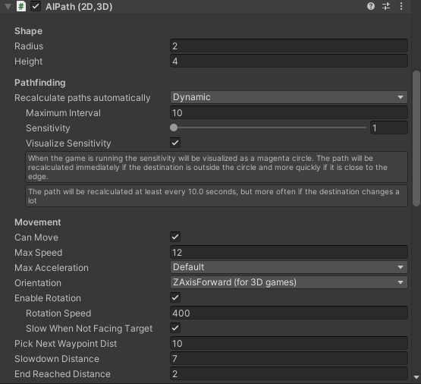
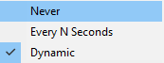
AI Path
Primary role is to make an agent follow a path generated by the Seeker
This class offers control over the agent's speed, movement behavior, and how often to recalculate path.

Slide 6
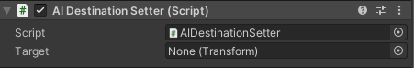
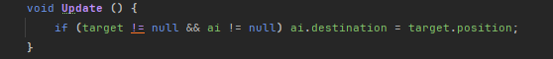
AI Destination Setter
Instead of manually setting the target in AIPath script, destination setter updates the target for you.
Will keep AIPath notified and allow for recalculations dynamically.

Slide 7
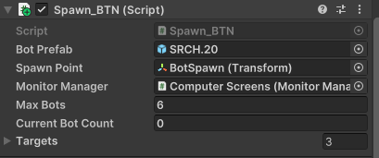
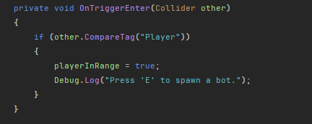
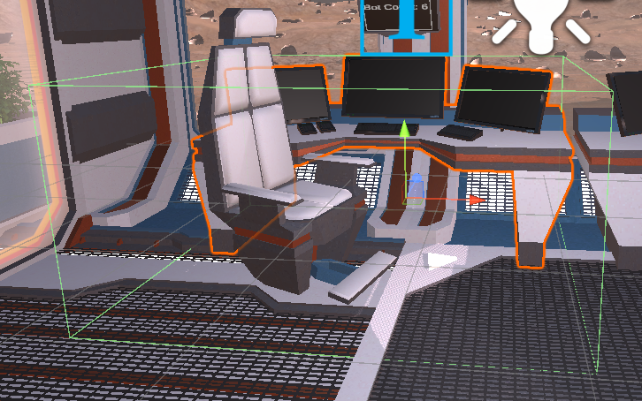
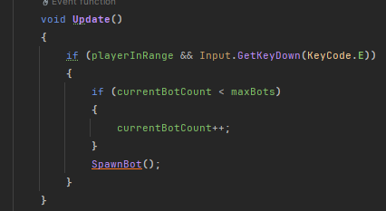
Spawn Button
The control room is where we spawn the bots.
This desk has a trigger box around it to allow the player to spawn bots.
If the player is in range and presses the interaction key, we increase currentbot count and spawn one.
Current bot count updates the top screen with the number of bots we have spawned.

Slide 8
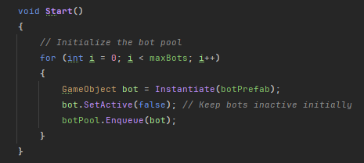
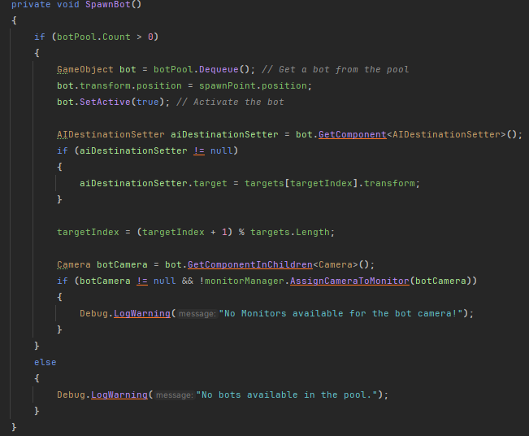
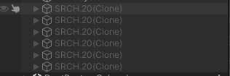
Optimizations to spawning
I used a pooling technique which reduces memory allocation and garbage collection.
On start(), we instantiate 6 inactive bots
SpawnBot() pulls a bot from the queue
Transformed the bot to the spawn point
Assigns the target using Destination Setter
Assigns the camera to an open monitor

Slide 9
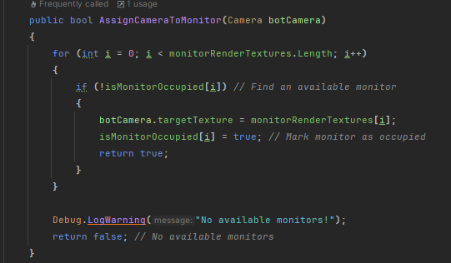
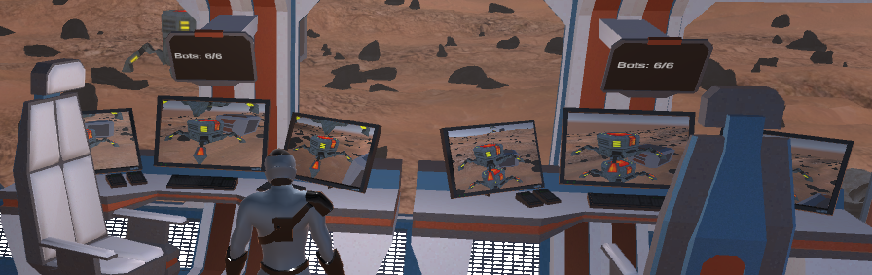
Control Room Monitors
With the monitors in the control room, I wrote a script to assign the bot camera to an unoccupied monitor.
We have a limit of 6 bots, with 6 monitors. Upon spawning the bot, its camera gets attached to the render texture for each monitor.

Slide 10
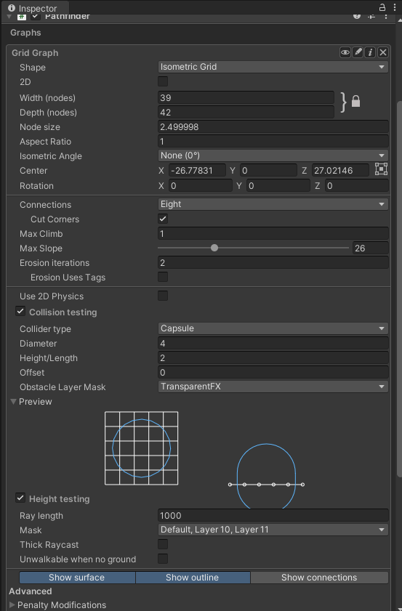
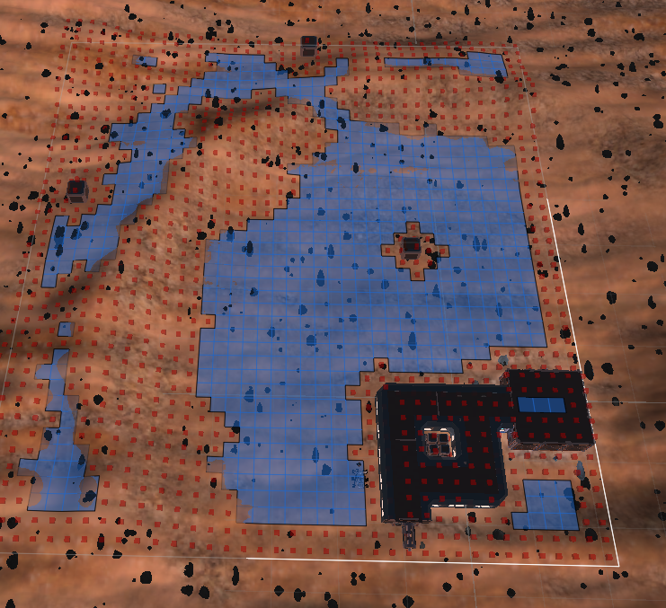
Terrain Scan
For optimizations, I changed the grid shape to isometric grid and scaled it to only encompass the areas agents will navigate.
Scaling it down to playable area reduces the calculations needed to find the best route.

Slide 11
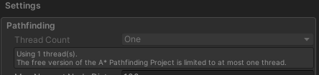
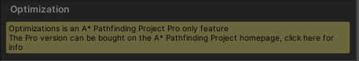
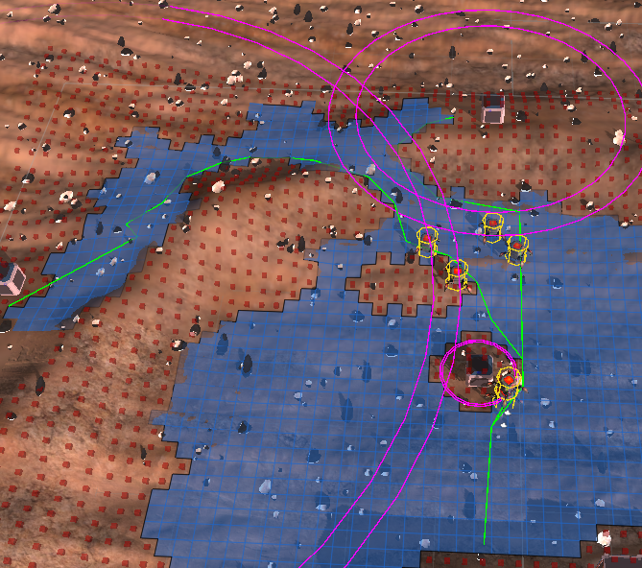
Multithreading
Ultimately, I would like to assign each path calculation to a unity job to take advantage of Burst compiler and multithreading.
Unfortunately, with the free version of this A* pathfinding, multithreading was disabled.

Slide 12
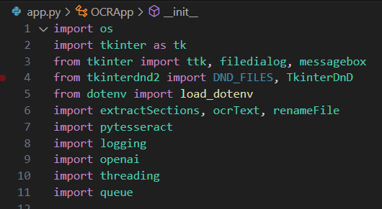
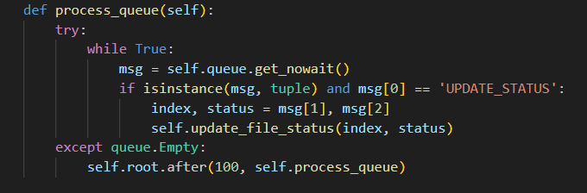
OCR Application

